Slide 1



深度學習 Deep Learning
Convolutional Neural Networks
(CNN)
Instructor: 林英嘉 (Ying-Jia Lin)
2025/10/08
Course GitHub
Slido # DL1008

Slide 2
Outline
Images [10 min]
Convolutional Neural Networks [50 min]
CV (Computer Vision) in PyTorch [40 min]
HW2 [30 min]
Quiz [20 min]

Slide 3
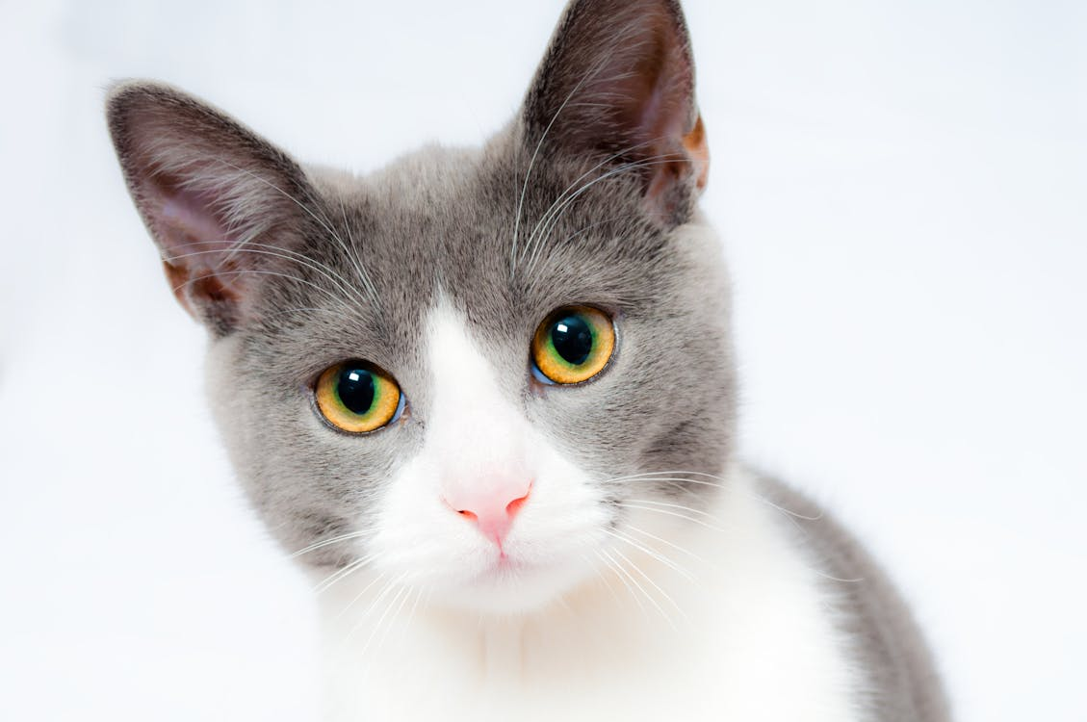

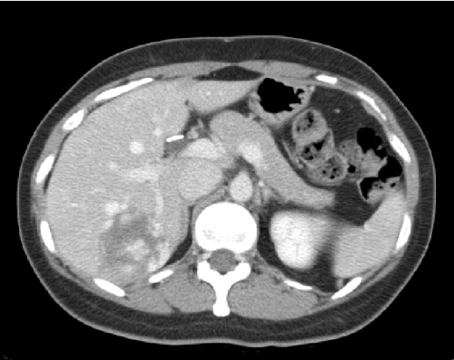
什麼是機器學習？(以電腦視覺為例)
Machine Learning function!
Cat
Classifier
Dog
Apple
Classifier
Malignant
Benign

Slide 4
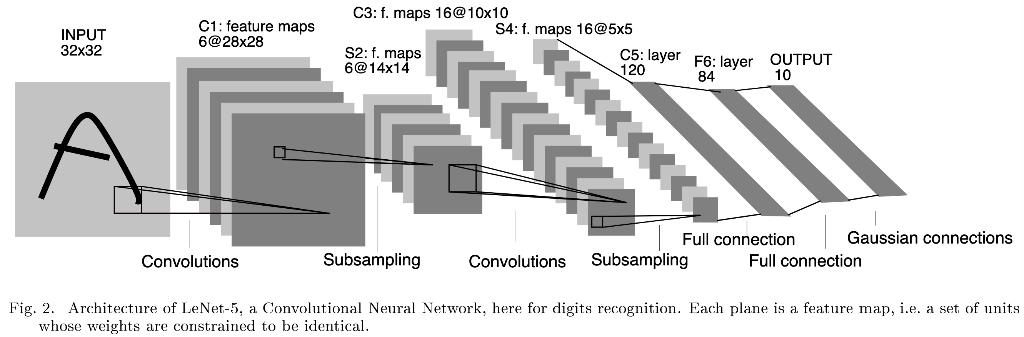
LeNet-5: Early Convolutional Neural Networks
LeCun, Y., Bottou, L., Bengio, Y., & Haffner, P. (1998). Gradient-based learning applied to document recognition. Proceedings of the IEEE, 86(11), 2278-2324.

Slide 5


Examples of Convolutions
Padding = 0, stride = 1
Padding = 0, stride = 2
Figure source: https://hannibunny.github.io/mlbook/neuralnetworks/convolutionDemos.html

Slide 6

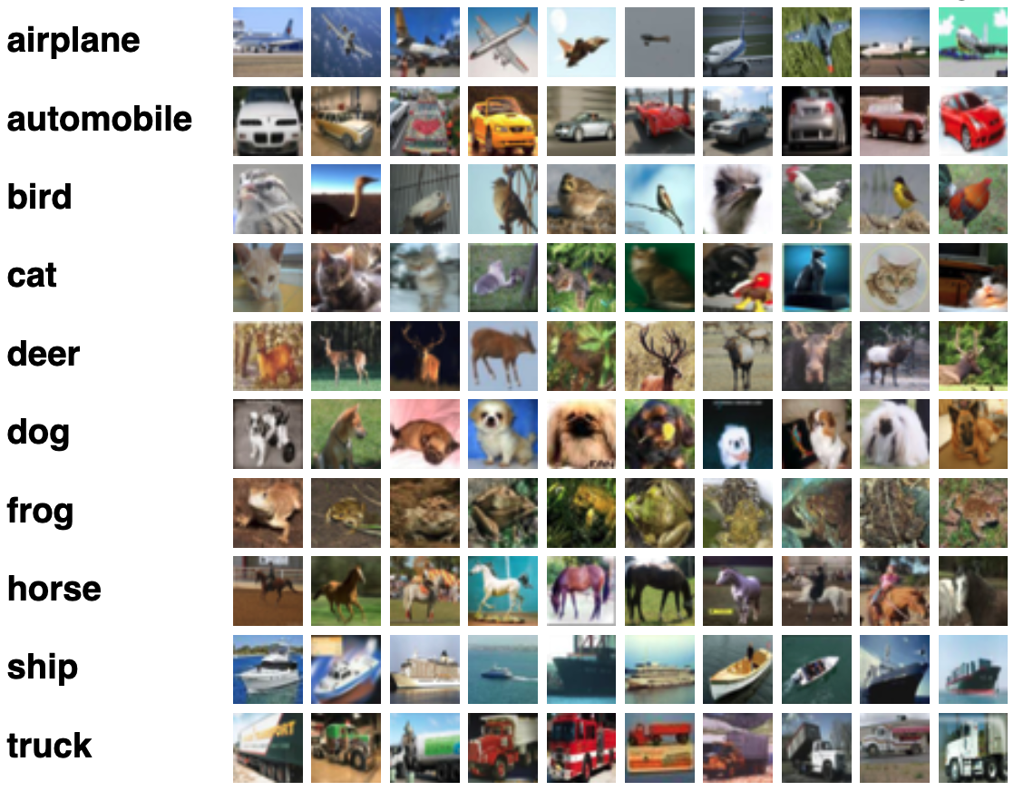
Images
MNIST
CIFAR-10
http://yann.lecun.com/exdb/mnist/
https://www.cs.toronto.edu/~kriz/cifar.html

Slide 7

RGB Images (彩色影像)
RGB 代表紅色 (Red)、綠色 (Green) 及藍色 (Blue)
Example shape:
(3, 128, 128)
Blue
Channel
Green
Channel
Red
Channel
channels
height
width

Slide 8

Gray-scale Images (灰階影像)
灰階影像只有一個 channel
Example shape:
(1, 128, 128)
channels
height
width

Slide 9
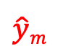
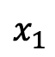
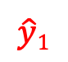
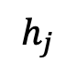
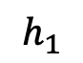
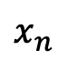
Image inputs are too big for an MLP
128 * 128
...
$$x_{1}$$
$$h_{1}$$
$$\hat{y}1$$
128 * 128
3 * 128 * 128 = 49,152
...
...
...
...
$$x_{n}$$
$$h_{j}$$
$$\hat{y}m$$
n = 49,152
128 * 128
...

Slide 10
Convolutional Neural Networks
CNN

Slide 11
卷積層有兩個重要的設定參數
https://docs.pytorch.org/docs/stable/generated/torch.nn.Conv2d.html
stride (int): 步長，代表卷積一次走幾個像素點
padding (int): 影像的四個邊要不要補 0
0 | 0 | 0 | 0 | 0 | 0
0 | 1 | 1 | 0 | 1 | 0
0 | 0 | 1 | 1 | 0 | 0
0 | 0 | 1 | 1 | 1 | 0
0 | 0 | 0 | 1 | 1 | 0
0 | 0 | 0 | 0 | 0 | 0
Padding = 0, stride = 2
Figure source: https://hannibunny.github.io/mlbook/neuralnetworks/convolutionDemos.html
(白色代表原始影像區域，橘紅色代表padding)

Slide 12
Convolutions (stride = 1)
Stride = 1
沒有 padding
1 | 1 | 1 | 1 | 0 | 0
0 | 1 | 1 | 0 | 1 | 0
0 | 0 | 1 | 1 | 0 | 0
0 | 0 | 1 | 1 | 1 | 0
0 | 0 | 0 | 1 | 1 | 0
0 | 0 | 0 | 0 | 0 | 0
1 | 0 | 0
0 | 1 | 0
0 | 0 | -1
1
Filter

Slide 13
Convolutions (stride = 1)
Stride = 1
沒有 padding
1 | 1 | 1 | 1 | 0 | 0
0 | 1 | 1 | 0 | 1 | 0
0 | 0 | 1 | 1 | 0 | 0
0 | 0 | 1 | 1 | 1 | 0
0 | 0 | 0 | 1 | 1 | 0
0 | 0 | 0 | 0 | 0 | 0
1 | 0 | 0
0 | 1 | 0
0 | 0 | -1
1 | 1
Filter

Slide 14
Convolutions (stride = 1)
Stride = 1
沒有 padding
1 | 1 | 1 | 1 | 0 | 0
0 | 1 | 1 | 0 | 1 | 0
0 | 0 | 1 | 1 | 0 | 0
0 | 0 | 1 | 1 | 1 | 0
0 | 0 | 0 | 1 | 1 | 0
0 | 0 | 0 | 0 | 0 | 0
1 | 0 | 0
0 | 1 | 0
0 | 0 | -1
1 | 1 | 1
Filter

Slide 15
Convolutions (stride = 1)
Stride = 1
沒有 padding
1 | 1 | 1 | 1 | 0 | 0
0 | 1 | 1 | 0 | 1 | 0
0 | 0 | 1 | 1 | 0 | 0
0 | 0 | 1 | 1 | 1 | 0
0 | 0 | 0 | 1 | 1 | 0
0 | 0 | 0 | 0 | 0 | 0
1 | 0 | 0
0 | 1 | 0
0 | 0 | -1
1 | 1 | 1 | 2
Filter

Slide 16
Convolutions (stride = 1)
Stride = 1
沒有 padding
1 | 1 | 1 | 1 | 0 | 0
0 | 1 | 1 | 0 | 1 | 0
0 | 0 | 1 | 1 | 0 | 0
0 | 0 | 1 | 1 | 1 | 0
0 | 0 | 0 | 1 | 1 | 0
0 | 0 | 0 | 0 | 0 | 0
1 | 0 | 0
0 | 1 | 0
0 | 0 | -1
1 | 1 | 1 | 2
-1
Filter

Slide 17
Convolutions (stride = 1)
Stride = 1
沒有 padding
1 | 1 | 1 | 1 | 0 | 0
0 | 1 | 1 | 0 | 1 | 0
0 | 0 | 1 | 1 | 0 | 0
0 | 0 | 1 | 1 | 1 | 0
0 | 0 | 0 | 1 | 1 | 0
0 | 0 | 0 | 0 | 0 | 0
1 | 0 | 0
0 | 1 | 0
0 | 0 | -1
1 | 1 | 1 | 2
-1 | 1
Filter

Slide 18
Convolutions (stride = 1)
Stride = 1
沒有 padding
1 | 1 | 1 | 1 | 0 | 0
0 | 1 | 1 | 0 | 1 | 0
0 | 0 | 1 | 1 | 0 | 0
0 | 0 | 1 | 1 | 1 | 0
0 | 0 | 0 | 1 | 1 | 0
0 | 0 | 0 | 0 | 0 | 0
1 | 0 | 0
0 | 1 | 0
0 | 0 | -1
1 | 1 | 1 | 2
-1 | 1 | 1 | 0
0 | 0 | 1 | 2
0 | 0 | 1 | 2
Filter
feature map

Slide 19
Convolutions (stride = 1)
Stride = 2
沒有 padding
1 | 1 | 1 | 1 | 0 | 0
0 | 1 | 1 | 0 | 1 | 0
0 | 0 | 1 | 1 | 0 | 0
0 | 0 | 1 | 1 | 1 | 0
0 | 0 | 0 | 1 | 1 | 0
0 | 0 | 0 | 0 | 0 | 0
1 | 0 | 0
0 | 1 | 0
0 | 0 | -1
1
Filter

Slide 20
Convolutions (stride = 2)
Stride = 2
沒有 padding
1 | 1 | 1 | 1 | 0 | 0
0 | 1 | 1 | 0 | 1 | 0
0 | 0 | 1 | 1 | 0 | 0
0 | 0 | 1 | 1 | 1 | 0
0 | 0 | 0 | 1 | 1 | 0
0 | 0 | 0 | 0 | 0 | 0
1 | 0 | 0
0 | 1 | 0
0 | 0 | -1
1 | 1
Filter

Slide 21
Convolutions (stride = 2)
Stride = 2
1 | 1 | 1 | 1 | 0 | 0
0 | 1 | 1 | 0 | 1 | 0
0 | 0 | 1 | 1 | 0 | 0
0 | 0 | 1 | 1 | 1 | 0
0 | 0 | 0 | 1 | 1 | 0
0 | 0 | 0 | 0 | 0 | 0
1 | 0 | 0
0 | 1 | 0
0 | 0 | -1
1 | 1
0
Filter

Slide 22
Convolutions (stride = 2)
Stride = 2
沒有 padding
1 | 1 | 1 | 1 | 0 | 0
0 | 1 | 1 | 0 | 1 | 0
0 | 0 | 1 | 1 | 0 | 0
0 | 0 | 1 | 1 | 1 | 0
0 | 0 | 0 | 1 | 1 | 0
0 | 0 | 0 | 0 | 0 | 0
1 | 0 | 0
0 | 1 | 0
0 | 0 | -1
1 | 1
0 | 1
Filter

Slide 23
Convolutions (stride = 2, padding = 1)
0 | 0 | 0 | 0 | 0 | 0 | 0 | 0
0 | 1 | 1 | 1 | 1 | 0 | 0 | 0
0 | 0 | 1 | 1 | 0 | 1 | 0 | 0
0 | 0 | 0 | 1 | 1 | 0 | 0 | 0
0 | 0 | 0 | 1 | 1 | 1 | 0 | 0
0 | 0 | 0 | 0 | 1 | 1 | 0 | 0
0 | 0 | 0 | 0 | 0 | 0 | 0 | 0
0 | 0 | 0 | 0 | 0 | 0 | 0 | 0
Stride = 2
有 padding
1 | 0 | 0
0 | 1 | 0
0 | 0 | -1
0
Filter
Padding

Slide 24
Convolutions (stride = 2, padding = 1)
0 | 0 | 0 | 0 | 0 | 0 | 0 | 0
0 | 1 | 1 | 1 | 1 | 0 | 0 | 0
0 | 0 | 1 | 1 | 0 | 1 | 0 | 0
0 | 0 | 0 | 1 | 1 | 0 | 0 | 0
0 | 0 | 0 | 1 | 1 | 1 | 0 | 0
0 | 0 | 0 | 0 | 1 | 1 | 0 | 0
0 | 0 | 0 | 0 | 0 | 0 | 0 | 0
0 | 0 | 0 | 0 | 0 | 0 | 0 | 0
Stride = 2
有 padding
1 | 0 | 0
0 | 1 | 0
0 | 0 | -1
0 | 1
Filter
Padding

Slide 25
Convolutions (stride = 2, padding = 1)
0 | 0 | 0 | 0 | 0 | 0 | 0 | 0
0 | 1 | 1 | 1 | 1 | 0 | 0 | 0
0 | 0 | 1 | 1 | 0 | 1 | 0 | 0
0 | 0 | 0 | 1 | 1 | 0 | 0 | 0
0 | 0 | 0 | 1 | 1 | 1 | 0 | 0
0 | 0 | 0 | 0 | 1 | 1 | 0 | 0
0 | 0 | 0 | 0 | 0 | 0 | 0 | 0
0 | 0 | 0 | 0 | 0 | 0 | 0 | 0
Stride = 2
有 padding
1 | 0 | 0
0 | 1 | 0
0 | 0 | -1
0 | 1 | 0
Filter
Padding

Slide 26
Convolutions (stride = 2, padding = 1)
0 | 0 | 0 | 0 | 0 | 0 | 0 | 0
0 | 1 | 1 | 1 | 1 | 0 | 0 | 0
0 | 0 | 1 | 1 | 0 | 1 | 0 | 0
0 | 0 | 0 | 1 | 1 | 0 | 0 | 0
0 | 0 | 0 | 1 | 1 | 1 | 0 | 0
0 | 0 | 0 | 0 | 1 | 1 | 0 | 0
0 | 0 | 0 | 0 | 0 | 0 | 0 | 0
0 | 0 | 0 | 0 | 0 | 0 | 0 | 0
Stride = 2
有 padding
1 | 0 | 0
0 | 1 | 0
0 | 0 | -1
0 | 1 | 0
0
Filter
Padding

Slide 27
Convolutions (stride = 2, padding = 1)
0 | 0 | 0 | 0 | 0 | 0 | 0 | 0
0 | 1 | 1 | 1 | 1 | 0 | 0 | 0
0 | 0 | 1 | 1 | 0 | 1 | 0 | 0
0 | 0 | 0 | 1 | 1 | 0 | 0 | 0
0 | 0 | 0 | 1 | 1 | 1 | 0 | 0
0 | 0 | 0 | 0 | 1 | 1 | 0 | 0
0 | 0 | 0 | 0 | 0 | 0 | 0 | 0
0 | 0 | 0 | 0 | 0 | 0 | 0 | 0
Stride = 2
1 | 0 | 0
0 | 1 | 0
0 | 0 | -1
0 | 1 | 0
0 | 1
Filter
Padding

Slide 28
Convolutions (stride = 2)
padding=1
0 | 0 | 0 | 0 | 0 | 0 | 0 | 0
0 | 1 | 1 | 1 | 1 | 0 | 0 | 0
0 | 0 | 1 | 1 | 0 | 1 | 0 | 0
0 | 0 | 0 | 1 | 1 | 0 | 0 | 0
0 | 0 | 0 | 1 | 1 | 1 | 0 | 0
0 | 0 | 0 | 0 | 1 | 1 | 0 | 0
0 | 0 | 0 | 0 | 0 | 0 | 0 | 0
0 | 0 | 0 | 0 | 0 | 0 | 0 | 0
Stride = 2
1 | 0 | 0
0 | 1 | 0
0 | 0 | -1
0 | 1 | 0
0 | 1 | 0
Filter
Padding

Slide 29
Convolutions (stride = 2)
padding=1
0 | 0 | 0 | 0 | 0 | 0 | 0 | 0
0 | 1 | 1 | 1 | 1 | 0 | 0 | 0
0 | 0 | 1 | 1 | 0 | 1 | 0 | 0
0 | 0 | 0 | 1 | 1 | 0 | 0 | 0
0 | 0 | 0 | 1 | 1 | 1 | 0 | 0
0 | 0 | 0 | 0 | 1 | 1 | 0 | 0
0 | 0 | 0 | 0 | 0 | 0 | 0 | 0
0 | 0 | 0 | 0 | 0 | 0 | 0 | 0
Stride = 2
1 | 0 | 0
0 | 1 | 0
0 | 0 | -1
0 | 1 | 0
0 | 1 | 0
0
Filter
Padding

Slide 30
Convolutions (stride = 2)
padding=1
0 | 0 | 0 | 0 | 0 | 0 | 0 | 0
0 | 1 | 1 | 1 | 1 | 0 | 0 | 0
0 | 0 | 1 | 1 | 0 | 1 | 0 | 0
0 | 0 | 0 | 1 | 1 | 0 | 0 | 0
0 | 0 | 0 | 1 | 1 | 1 | 0 | 0
0 | 0 | 0 | 0 | 1 | 1 | 0 | 0
0 | 0 | 0 | 0 | 0 | 0 | 0 | 0
0 | 0 | 0 | 0 | 0 | 0 | 0 | 0
Stride = 2
1 | 0 | 0
0 | 1 | 0
0 | 0 | -1
0 | 1 | 0
0 | 1 | 0
0 | 0
Filter
Padding

Slide 31
Convolutions (stride = 2)
padding=1
0 | 0 | 0 | 0 | 0 | 0 | 0 | 0
0 | 1 | 1 | 1 | 1 | 0 | 0 | 0
0 | 0 | 1 | 1 | 0 | 1 | 0 | 0
0 | 0 | 0 | 1 | 1 | 0 | 0 | 0
0 | 0 | 0 | 1 | 1 | 1 | 0 | 0
0 | 0 | 0 | 0 | 1 | 1 | 0 | 0
0 | 0 | 0 | 0 | 0 | 0 | 0 | 0
0 | 0 | 0 | 0 | 0 | 0 | 0 | 0
Stride = 2
1 | 0 | 0
0 | 1 | 0
0 | 0 | -1
0 | 1 | 0
0 | 1 | 0
0 | 0 | 2
Filter
Padding

Slide 32
Filters 數目與 output_channels 的關係
Filters 的數目可以調整
對輸入層來說，1 個 filter 照顧 3 個 channels 的資料，輸出 1 個 feature map
使用 64 個 filters，就會輸出 64 個 feature maps
可調整參數為: num_filters * input_channels * filter_size * filter_size

Slide 33
Convolutions (RGB)
filters 數值可能都是不同的！(為了方便計算，簡報使用一樣的數字)
B
1 | 0 | 0
0 | 1 | 0
0 | 0 | -1
1 | 1 | 1
0 | 1 | 1
0 | 0 | 1
1 | 1 | 1 | 1 | 0 | 0
0 | 1 | 1 | 0 | 1 | 0
0 | 0 | 1 | 1 | 0 | 0
0 | 0 | 1 | 1 | 1 | 0
0 | 0 | 0 | 1 | 1 | 0
0 | 0 | 0 | 0 | 0 | 0
G
1 | 1 | 1 | 1 | 0 | 0
0 | 1 | 1 | 0 | 1 | 0
0 | 0 | 1 | 1 | 0 | 0
0 | 0 | 1 | 1 | 1 | 0
0 | 0 | 0 | 1 | 1 | 0
0 | 0 | 0 | 0 | 0 | 0
R
1 | 1 | 1 | 1 | 0 | 0
0 | 1 | 1 | 0 | 1 | 0
0 | 0 | 1 | 1 | 0 | 0
0 | 0 | 1 | 1 | 1 | 0
0 | 0 | 0 | 1 | 1 | 0
0 | 0 | 0 | 0 | 0 | 0
先各自與Filter做內積後相加
(R) Filter
1 | 0 | 0
0 | 1 | 0
0 | 0 | -1
1 | 0 | 1
0 | 1 | 1
0 | 0 | 1
3 | 0 | 0
0 | 3 | 0
0 | 0 | -3
(G) Filter
1 | 0 | 0
0 | 1 | 0
0 | 0 | -1
1 | 0 | 0
0 | 1 | 1
1 | 0 | 1
3
(B) Filter

Slide 34
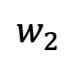
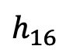
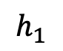
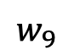
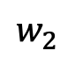
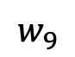
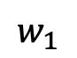
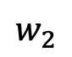
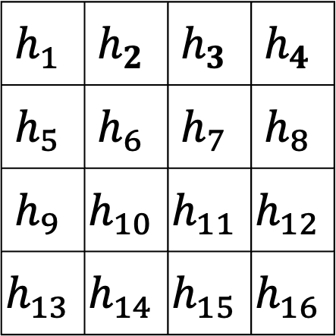
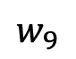
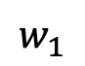
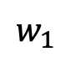
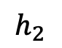
Convolutional layer is not fully-connected
$$w_{1}$$
1 | 0 | 0
0 | 1 | 0
0 | 0 | -1
1 | 1 | 1 | 1 | 0 | 0
0 | 1 | 1 | 0 | 1 | 0
0 | 0 | 1 | 1 | 0 | 0
0 | 0 | 1 | 1 | 1 | 0
0 | 0 | 0 | 1 | 1 | 0
0 | 0 | 0 | 0 | 0 | 0
$$w_{2}$$
...
$$w_{9}$$
$$h_{1}$$
Filter, stride=1
$$w_{1}$$
$$w_{2}$$
$$h_{2}$$
$$h_{1}$$ | $$h_{2}$$ | $$h_{3}$$ | $$h_{4}$$
$$h_{5}$$ | $$h_{6}$$ | $$h_{7}$$ | $$h_{8}$$
$$h_{9}$$ | $$h_{10}$$ | $$h_{11}$$ | $$h_{12}$$
$$h_{13}$$ | $$h_{14}$$ | $$h_{15}$$ | $$h_{16}$$
36
$$w_{9}$$
...
...
$$h_{16}$$
$$w_{1}$$
$$w_{2}$$
...
feature map
$$w_{9}$$

Slide 35
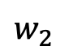
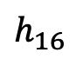
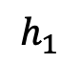
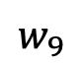
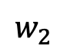
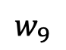
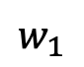
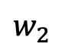
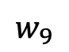
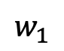
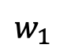
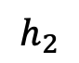
Convolutional layer vs. FC layer 參數量
$$w_{1}$$
$$w_{2}$$
...
$$w_{9}$$
FC: fully-connected
$$h_{1}$$
$$w_{1}$$
Grayscale images | 參數量比較 (不算 bias 數)
FC layer | 36 * 16 = 576
Conv layer | 3 * 3 = 9
$$w_{2}$$
$$h_{2}$$
36
$$w_{9}$$
...
...
$$h_{16}$$
$$w_{1}$$
$$w_{2}$$
...
$$w_{9}$$

Slide 36
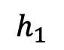
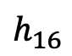
Convolutional layer vs. FC layer 參數量
3 * 3
...
FC: fully-connected
$$h_{1}$$
RGB images | 參數量比較 (不算 bias 數)
FC layer | 3 * 128 * 128 * 16 = 786,432
Conv layer (num_filter = 1) | 3 * 3 * 3 = 27
RGB images | 參數量比較 (不算 bias 數)
FC layer | 3 * 128 * 128 * 16 = 786,432
Conv layer (num_filter = 1) | 3 * 3 * 3 = 27
Conv layer (num_filter = 16) | 3 * 3 * 3 * 16 = 432
...
3 * 3
...
$$h_{16}$$
3 * 3
...

Slide 37
Implementation in PyTorch
我們使用 torch.nn.Conv2d
Why not 3d?
Number of Channels
(特徵維度)
2d 卷積僅沿著空間維度 (Height, Width) 進行
128
128

Slide 38
Pooling (example of Max Pooling)
1 | 3 | 1 | 2
-1 | 1 | 1 | 0
0 | 1 | 1 | 0
0 | 0 | 1 | 2
3 | 2
1 | 2
參數：
kernel_size=2
stride = 2

Slide 39
Pooling (example of Average Pooling)
1 | 3 | 1 | 2
-1 | 1 | 1 | 0
0 | 1 | 1 | 0
0 | 0 | 1 | 2
1 | 1
0.25 | 1
參數：
kernel_size=2
stride = 2

Slide 40
Pooling (example of Max Pooling)
1 | 3 | 1 | 2
-1 | 1 | 1 | 0
0 | 1 | 1 | 0
0 | 0 | 1 | 2
3 | 3 | 2
1 | 1 | 1
1 | 1 | 2
參數：
kernel_size=2
stride = 1

Slide 41
2D Pooling on RGB Images
64
64
224
112
參數：
kernel_size=2
stride = 2
112
224
224 x 224 x 64
(H x W x C)
112 x 112 x 64
(H x W x C)

Slide 42
[Important Notes] Meaning of Pooling
To maintain the most relevant information
Summarizing the features within the region covered by the filter
Shortage:
No theoretical guarantee for making better model performance

Slide 43
CNN 的結局
通常不會只有一層的 Convolutional Layer
隨著層數增加，通常 Feature map 會越來越小，因為：
Convolutional Layer 可能會縮小 feature map (如果沒有 padding)
Pooling 也會縮小 feature map
經過了多次的 Convolution + Pooling 後的 feature map 為壓縮後的重要資訊

Slide 44
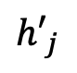
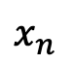
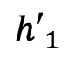
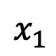

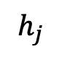
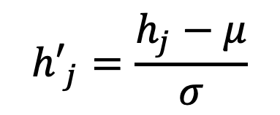
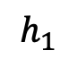
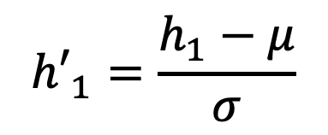
Batch Normalization (BN)
計算：$μ$ (平均數) & $σ$ (標準差)
$${h′}_{1}=\frac{h_{1}−μ}{σ}$$
$$x_{1}$$
$$h_{1}$$
$${h′}_{1}$$
...
...
...
$${h′}_{j}=\frac{h_{j}−μ}{σ}$$
$$x_{n}$$
$$h_{j}$$
$${h′}_{j}$$
Ioffe, Sergey, and Christian Szegedy. "Batch normalization: Accelerating deep network training by reducing internal covariate shift." International conference on machine learning. 2015.

Slide 45
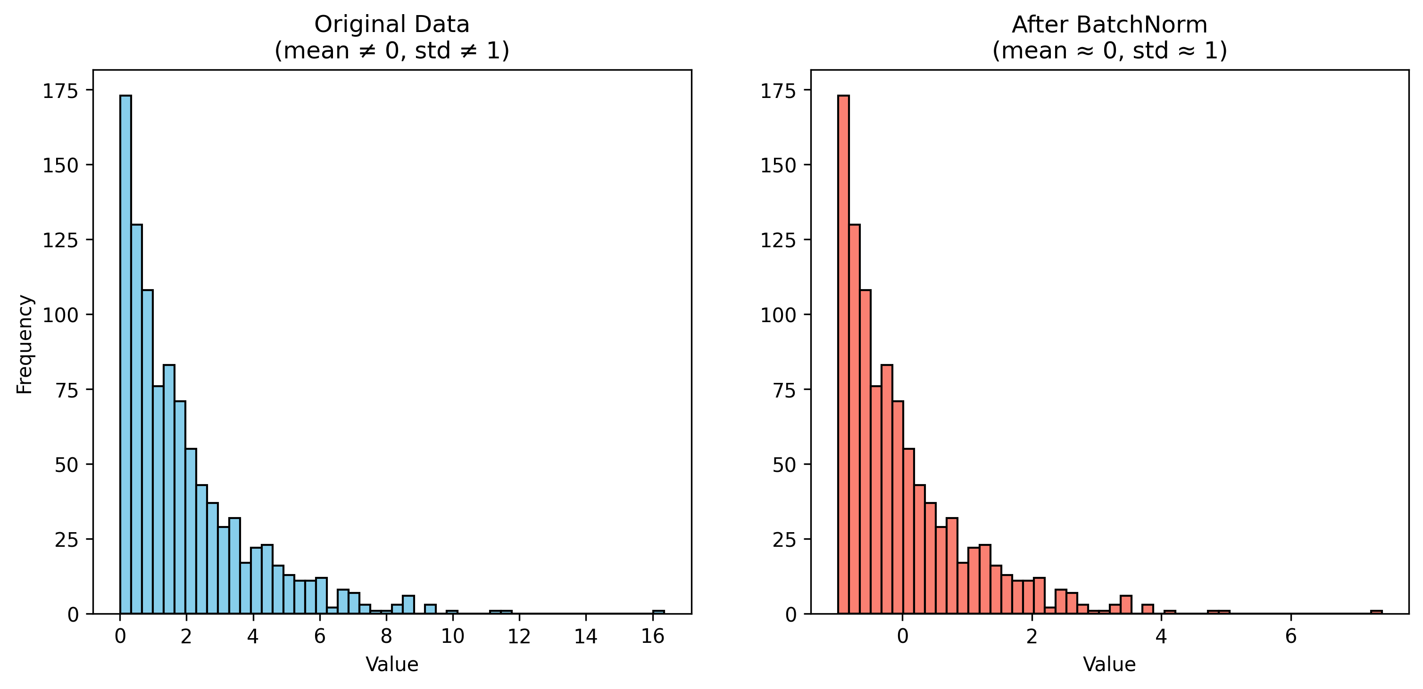
Value comparison example with BN

Slide 46
BN Summary
BN 對數值進行轉換，使得轉換後的數值的平均值為零、標準差為1，類似於統計上的 Z-score standardization
BN 可以：
減少不同特徵尺度帶來的偏差
提高模型訓練時的穩定性

Slide 47
The whole CNN
Convolution
Pooling
Flatten
BatchNorm
BatchNorm
Fully-connected Networks
Pooling
Convolution
…
Convolution
Classification
BatchNorm
Pooling

Slide 48
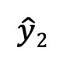
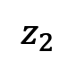
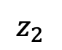
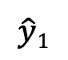





Fully-connected Networks
常被稱為全連接層 (Fully-connected layers, FC)
Multi-layer perceptron (MLP) 即是由 FC 所構成
注意! CNN 不是全連接層
$$x_{1}$$
$$z_{1}$$
$$x_{1}$$
$$z_{1}$$
$$\hat{y}1$$
Regression /
Binary Classification
$$\hat{y}1$$
Classification
$$x_{2}$$
$$z_{2}$$
$$x_{2}$$
$$z_{2}$$
$$\hat{y}2$$

Slide 49
Why Flatten?
以分類任務來說，我們需要 Fully-connected layers
CNN 常被用於分類任務

Slide 50
CNN Summary
為影像資料量身定做，用來捕捉空間資訊 (Spatial Information)
Parameter sharing (參數共享機制)
降低用 MLP 來進行影像任務的參數量

Slide 51


ConvNets are everywhere
Object Detection with YOLO
Style Transfer with CNN
Figure source: https://pjreddie.com/darknet/yolo/
Figure source: Gatys, Leon A., Alexander S. Ecker, and Matthias Bethge. "Image style transfer using convolutional neural networks." CVPR. 2016.

Slide 52
Advanced CNNs
[ResNet] Deep Residual Learning for Image Recognition
https://arxiv.org/abs/1512.03385
[DenseNet] Densely Connected Convolutional Networks
https://arxiv.org/abs/1608.06993
https://slazebni.cs.illinois.edu/spring17/lec04_advanced_cnn.pdf

Slide 53
Additional Links
PyTorch CNN example: https://pytorch.org/tutorials/beginner/blitz/cifar10_tutorial.html
Batch Normalization:
https://wandb.ai/wandb_fc/GroupNorm/reports/Group-Normalization-in-Pytorch-With-Examples---VmlldzoxMzU0MzMy
https://towardsdatascience.com/batch-norm-explained-visually-how-it-works-and-why-neural-networks-need-it-b18919692739/

Slide 54
Thank you!
Instructor: 林英嘉
✉️ yjlin@cgu.edu.tw
TA: 劉美辰
✉️ m1461014@cgu.edu.tw

